Slide 1
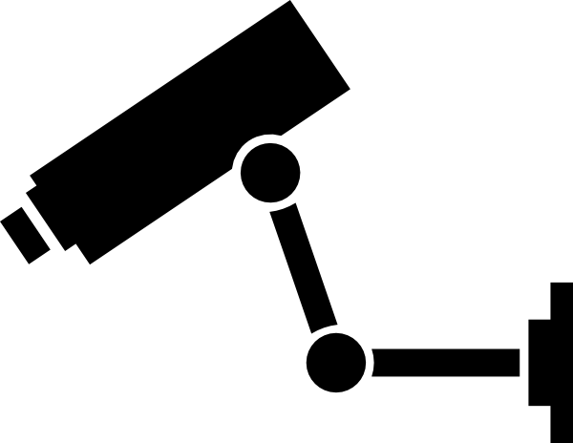
B.A.N Vision
Notes:
All

Slide 2
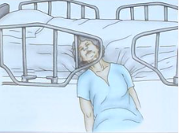
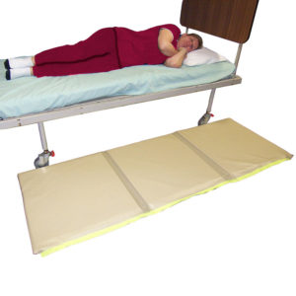

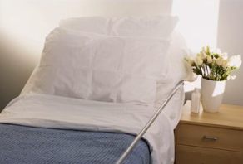
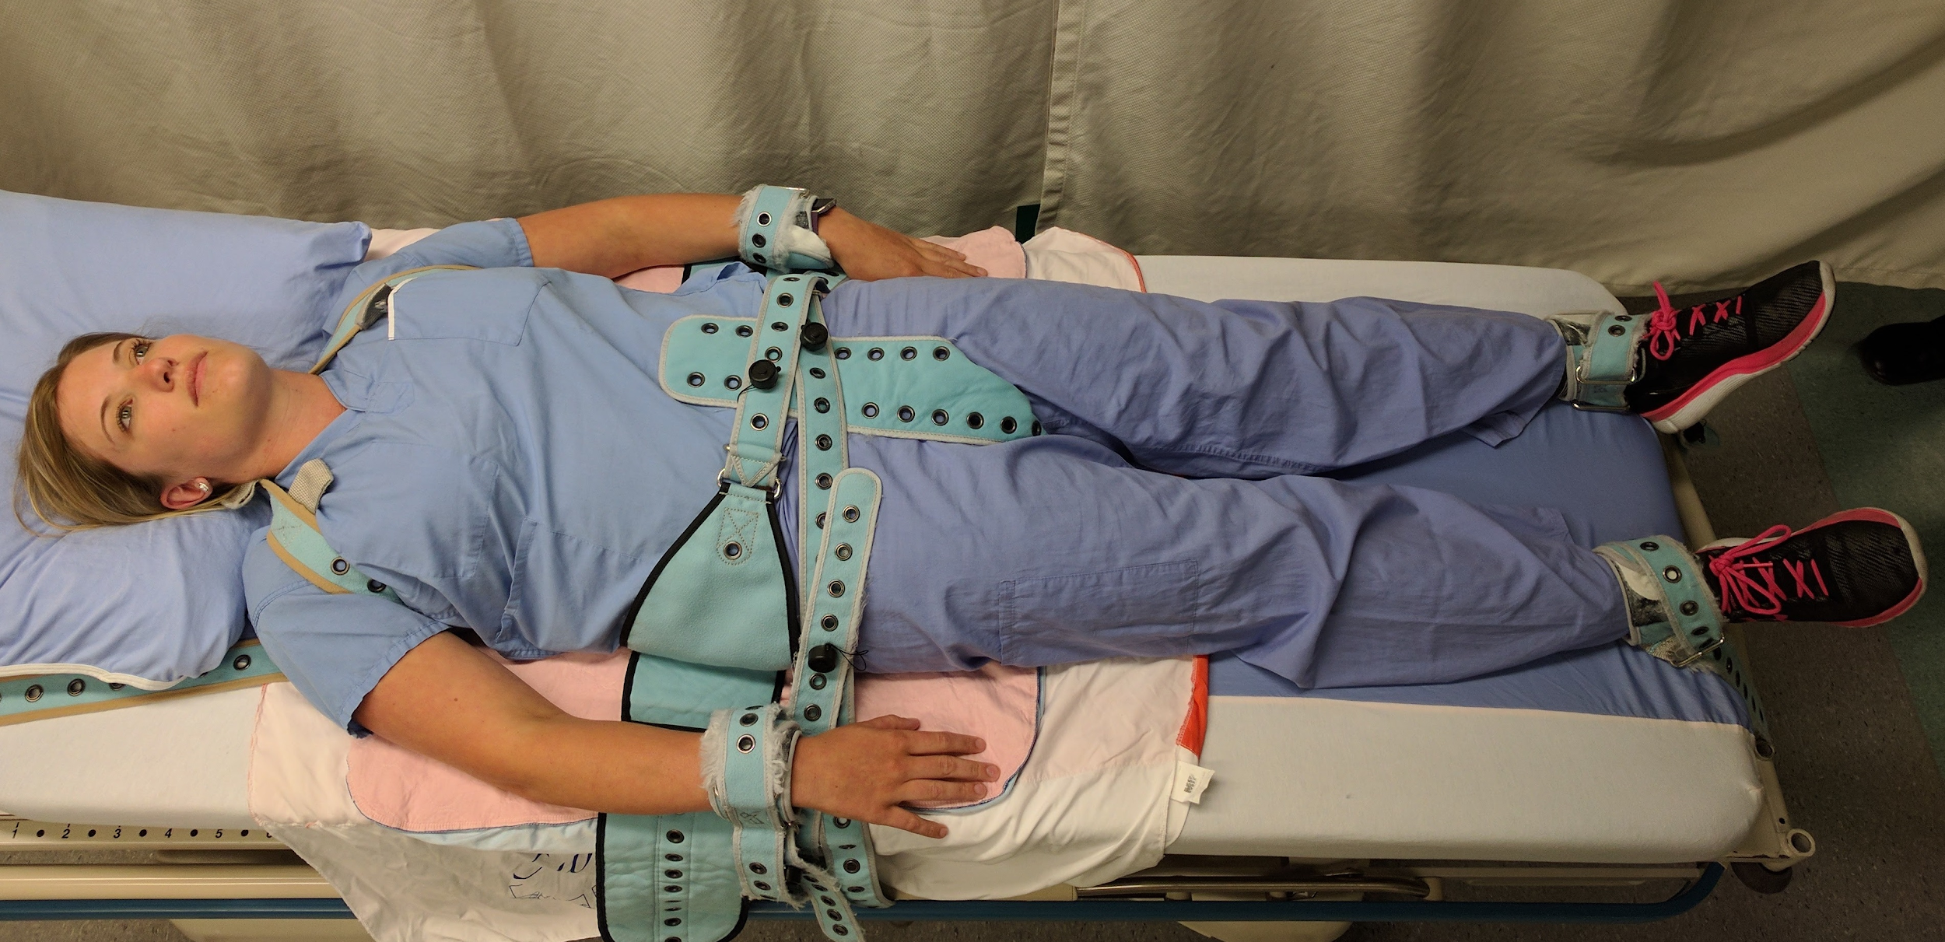
Problem
Notes:
Nick

Slide 3
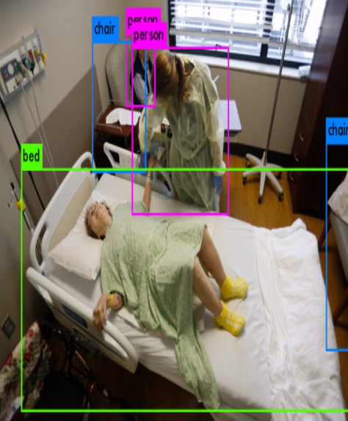
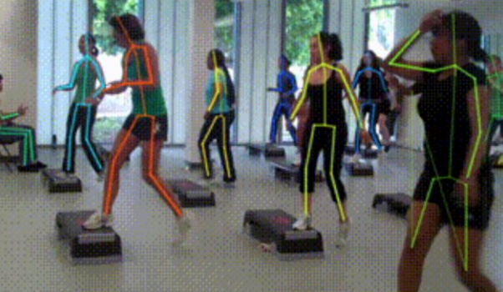
Solution
Object Recognition
Pose Estimation
Notes:
Nick

Slide 4
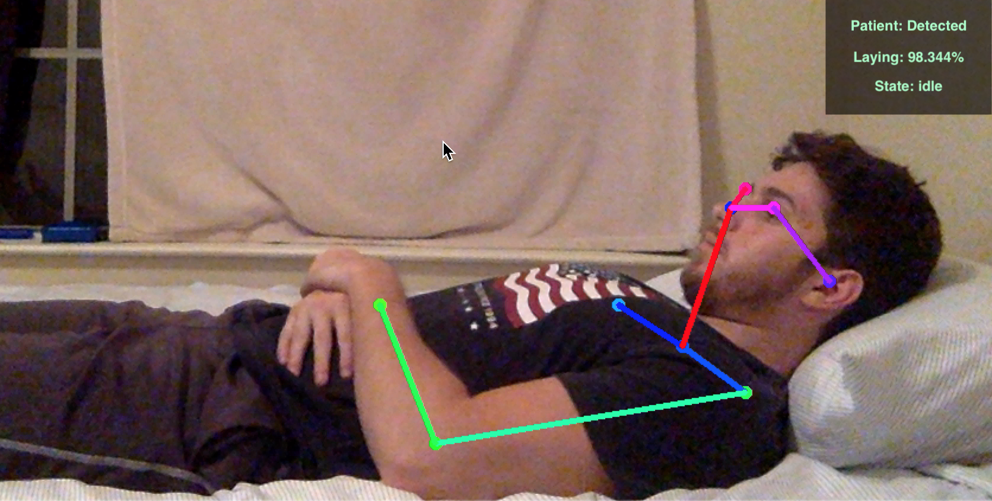
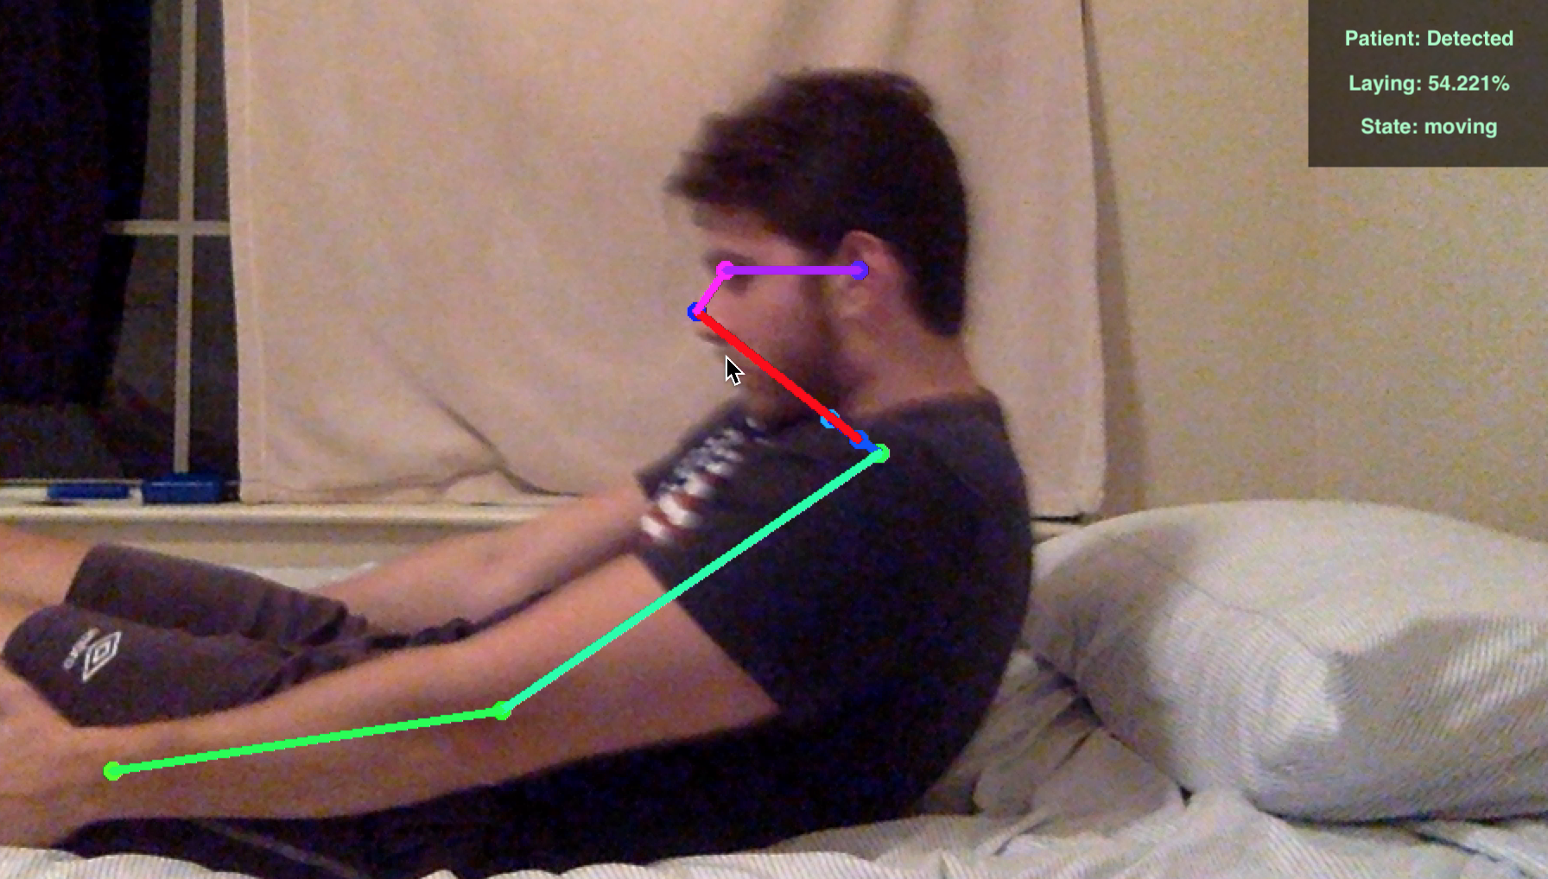
Demo (stills)
Laying Down
Getting Up
No Alert
Nurse Notified
Notes:
Nick

Slide 5
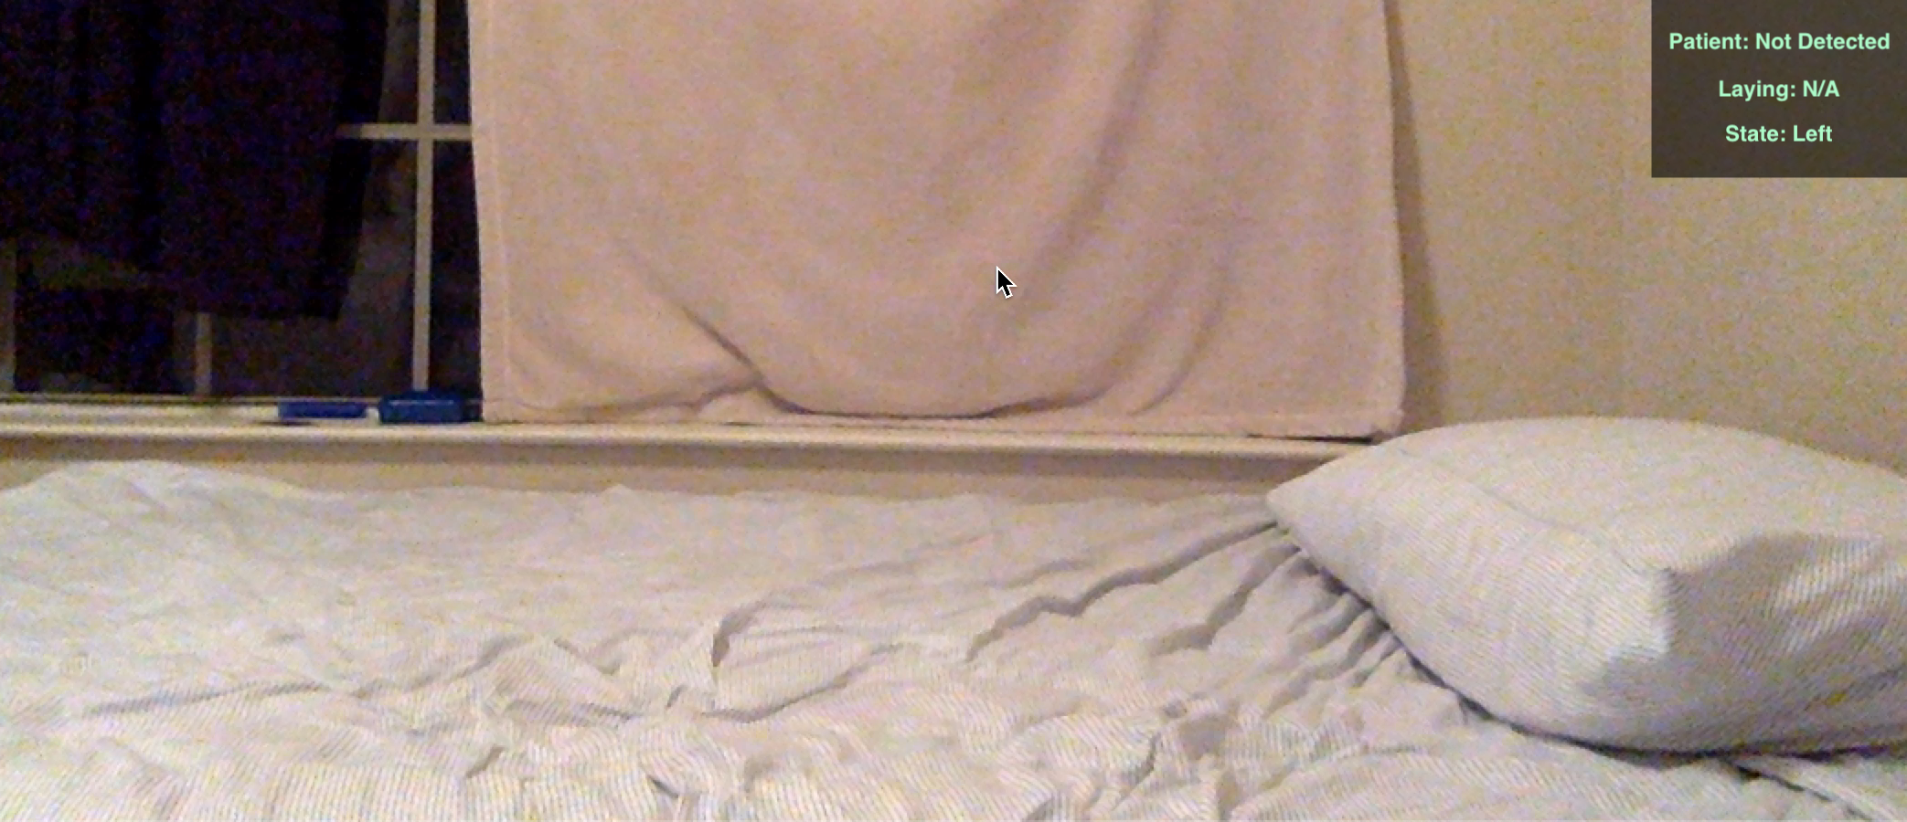
Demo (stills)
Patient Left
Nurse Notified
Alarm sounded
Notes:
Nick

Slide 6
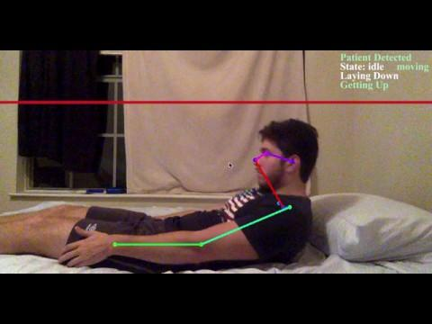
Demo
Notes:
Nick

Slide 7
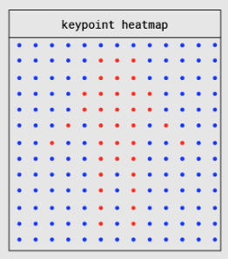
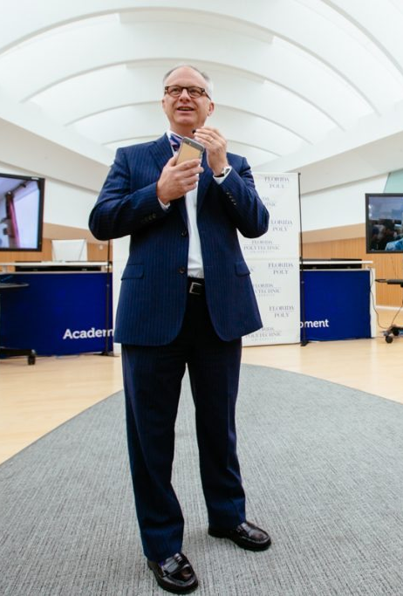
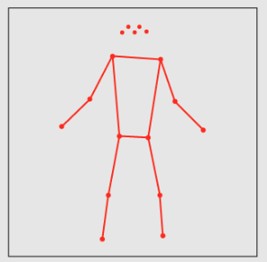
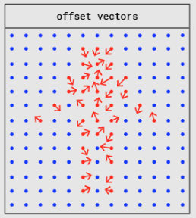
Details

Slide 8
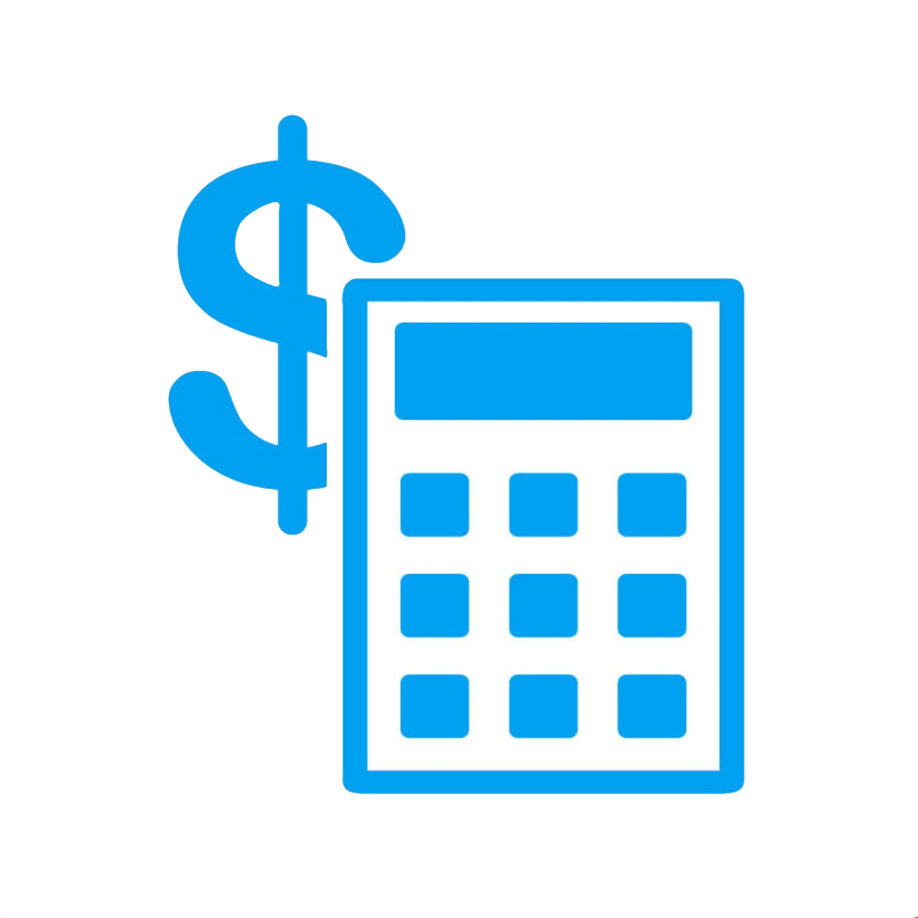
Economic Justification
Reducing falls by 10% saves the hospital $100,000
Price of beds reduced from $20,000 to $7,500
Reduce internal hardware components

Slide 9
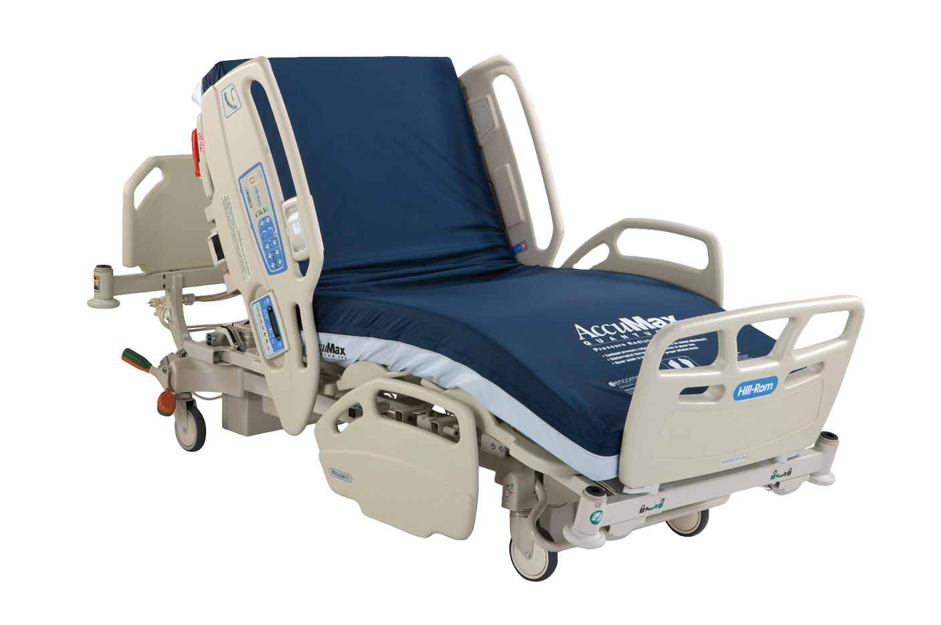
Similar Products
Hill-Rom Centrella Bed
23% fall reduction
All in one medical bed
Industry standard
$20,000
Too large and heavy
Pressure sensors

Slide 10



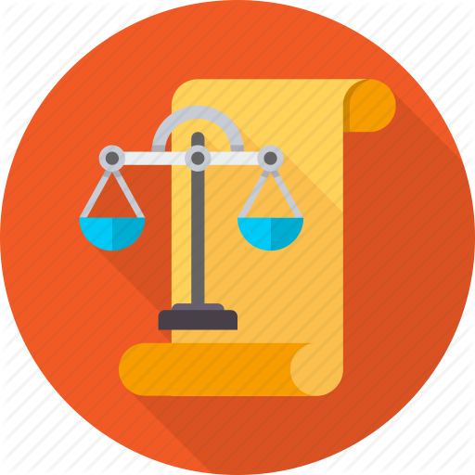
Design Constraints
Responsibility of patients’ safety
Must be easily reproduced without expert installation
Budget (soft)
< $20,000
Data storage/usage
HIPAA regulations
Notes:
merry christmas bitch @andre

Slide 11
Engineering Standards
The following engineering standards are being considered during design of BAN Vision:
IEEE 802.11-2016 - IEEE Standard for Information technology
IEEE 602-2007 - IEEE Recommended Practice for Electric Systems in Health Care Facilities
However, many engineering standards for machine learning are still in the works or are very specific and thus not applicable
ex. IEEE 1232.3-2014 - IEEE Guide for the Use of Artificial Intelligence Exchange and Service Tie to All Test Environments (AI-ESTATE)
ex. P7006 - Standard for Personal Data Artificial Intelligence (AI) Agent

Slide 12
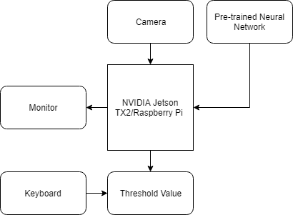
Functional Block Diagram

Slide 13
Budget
Initial soft budget: <$20,000
Materials used:
NVIDIA Jetson TX2 (~$600)
Raspberry Pi 3 (~$30)
Materials required:
For demo w/Jetson: none
For implementation: USB security camera (≥$100)
Total cost:
Worse case: $700
Best case: $130

Slide 14
Team Contribution
Andre Ripley - Computer Engineering
Team Leader
Machine Learning Technical Lead
Nick Huston - Computer Engineering
Software Developer
Lead Documenter
Brendan Crace - Electrical Engineering
Lead Researcher
Documenter
QA

Slide 15
Future Plans
Currently, the NVIDIA Jetson is throwing errors related to its architecture. We’re working on solving these issues at the moment, and exploring other options.
Introducing leg fixtures to reduce false positive readings.

Slide 16
Thanks!
Any questions?

